Slide 1
Hackathon Identifying New Bikes

Slide 2
Group Members
Ankit Dey(891114)
Chandranibha Ray(891170)
Pawan Kumar Sah(891172)
Puja Sarkar(891144)

Slide 3
Project Description
We have to navigate to www.zigwheels.com
Then we have to hover to <New Bikes>, select <Upcoming Bikes> from the drop down and then select <Honda> brand & finally print the model name, price and date of release for bikes with price under Rs. Four Lakhs.

Slide 4
Next we have to hover to <Used Cars> and select location <Chennai> and print the list of <Popular Models> of used cars in Chennai.
Then we will renavigate to the main page and click on <Login/Signup> button and will try to login with <click to login with Google> by entering invalid details.

Slide 5
Tools, Software Used
Selenium – Portable Framework for testing Web Applications and automating the process.
Java – High level Programming Language.
Eclipse – Integrated Development Environment for various ‘Languages’.
TestNG – Open source testing framework.
Maven – Software and project Management Tool.
POM – Object repository design pattern.
Selenium Grid - Specializing in running multiple tests across different browsers and operating systems.
Jenkins – An open source automation server for continuous integration.

Slide 6
Work Done
The code is written in JAVA language and then is further automated using Selenium, TestNG, Maven, Selenium Grid and Jenkins.
Page Object Model(POM) is used to reduce the code duplication for various instances and to improve code readability.
Data obtained from website is stored in Excel Sheet using Apache POI; also, data input is taken from a file with variables written in it.
Jenkins and Maven repositories are also used, so as to make it easy to make changes to various versions of code and to modularise it; also to help with continuous integration.

Slide 7
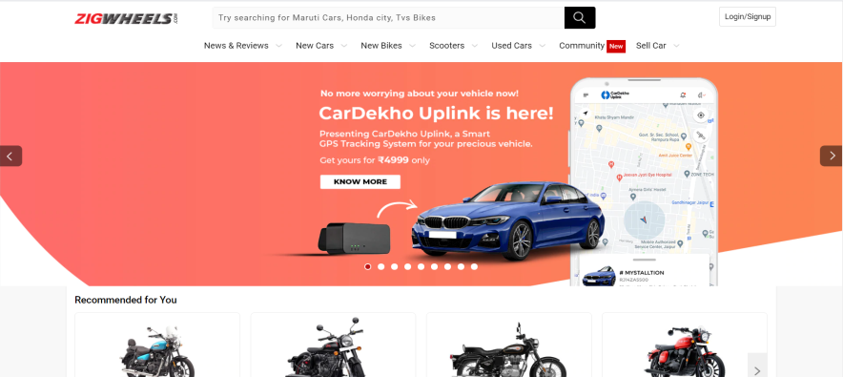
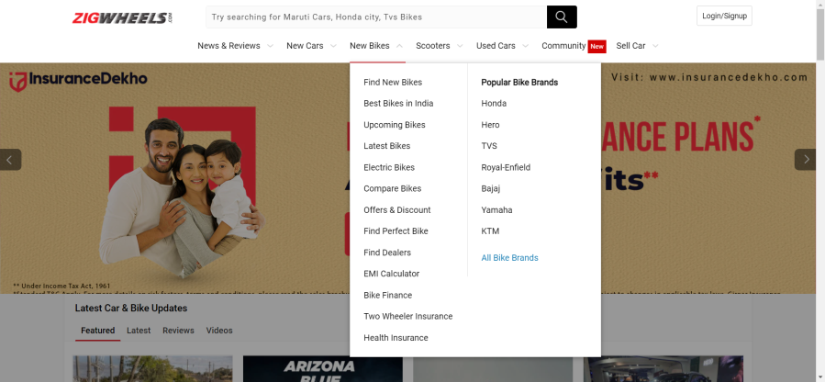
Screenshots
Home Page
New Bikes

Slide 8
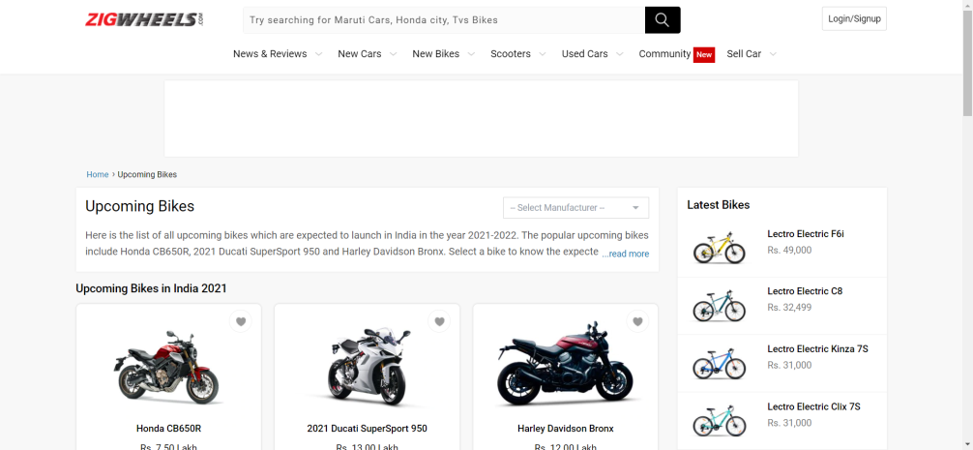
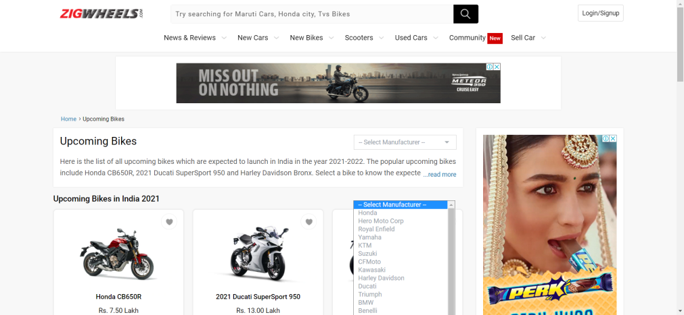
Upcoming Bikes
Manufacturer List

Slide 9
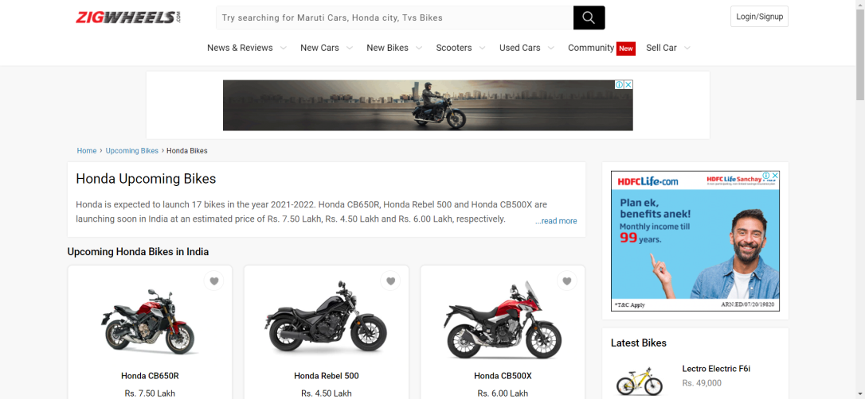
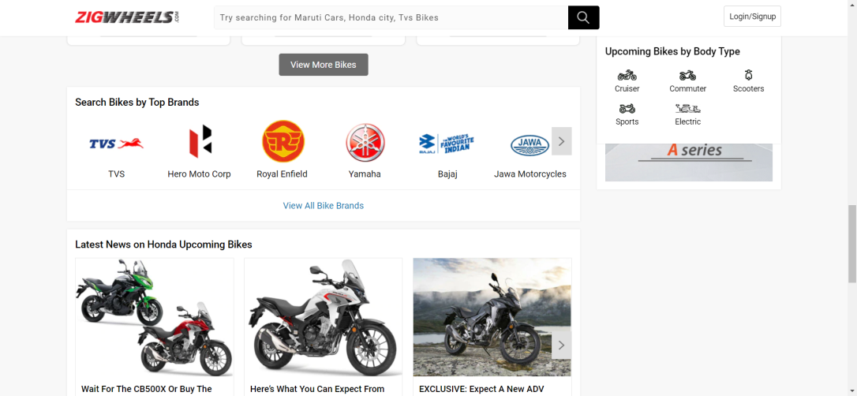
Honda bikes
View More

Slide 10
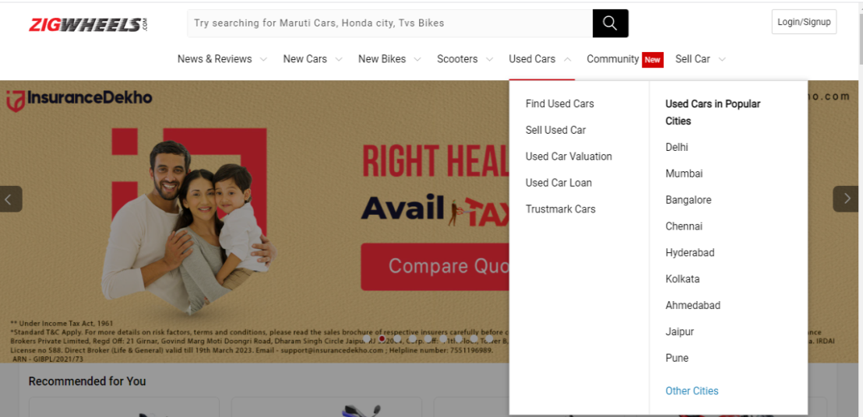
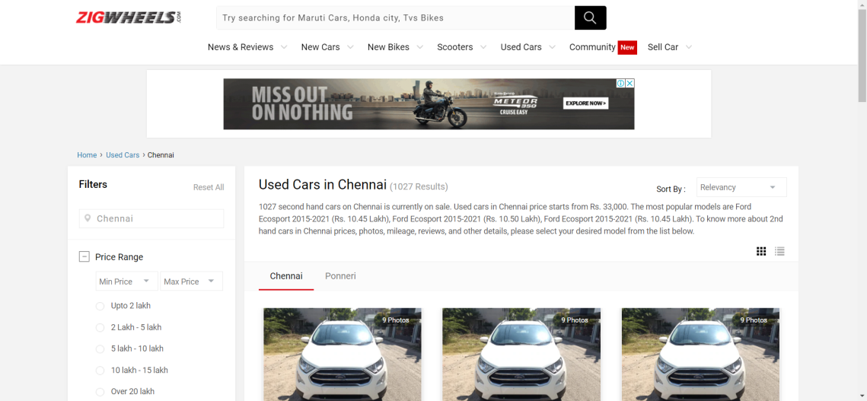
Used Cars
Used cars in Chennai

Slide 11
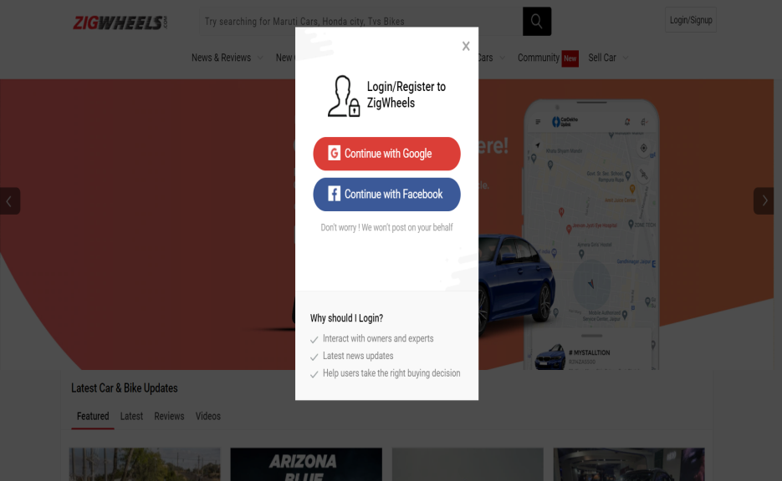
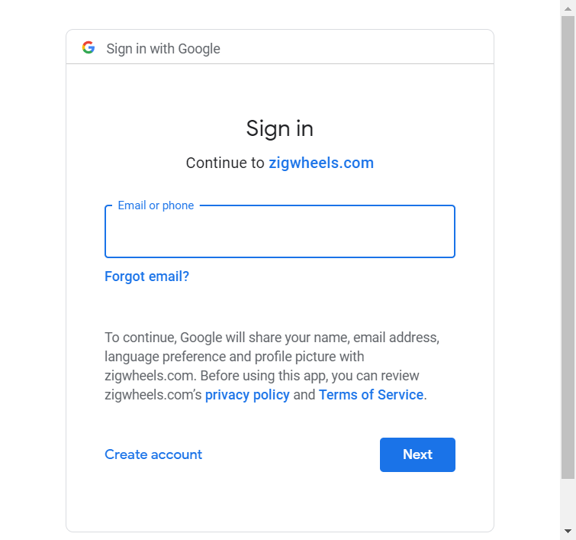
Login
Login Window

Slide 12

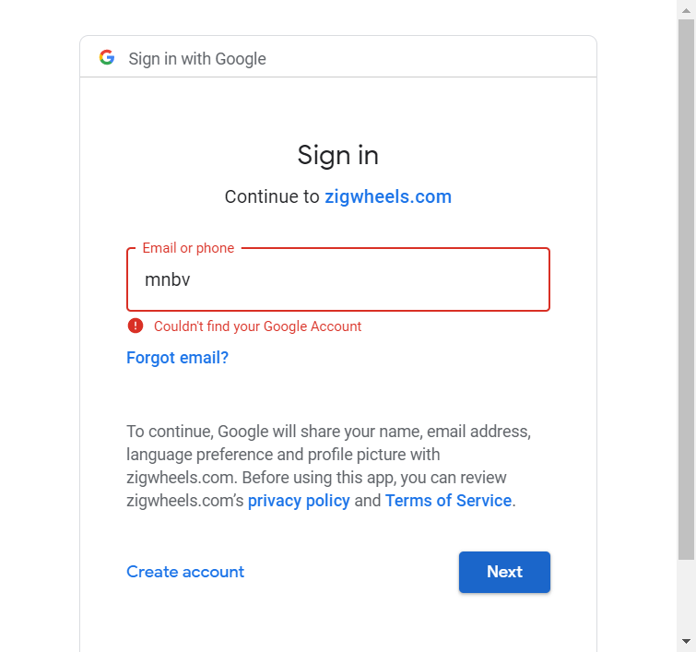
Invalid Username
Warning Message

Slide 13
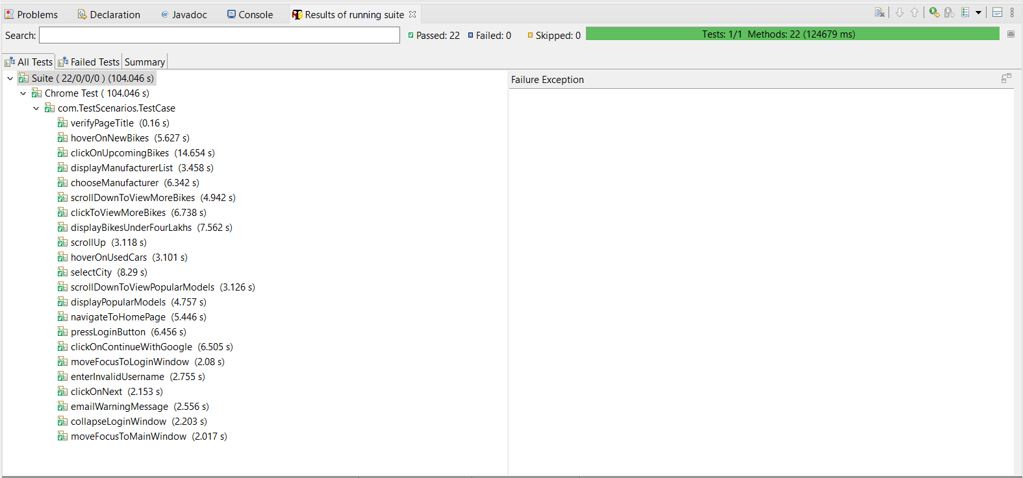
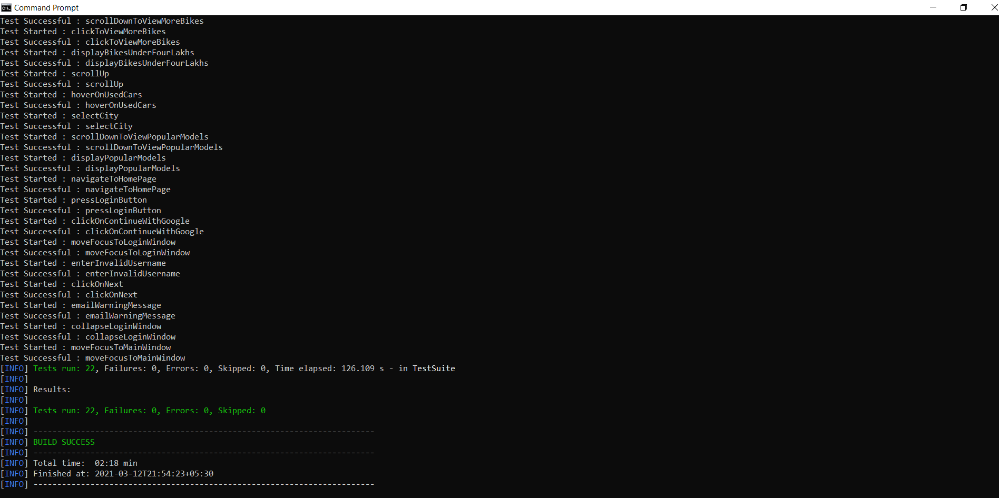
Selenium output
Maven output

Slide 14
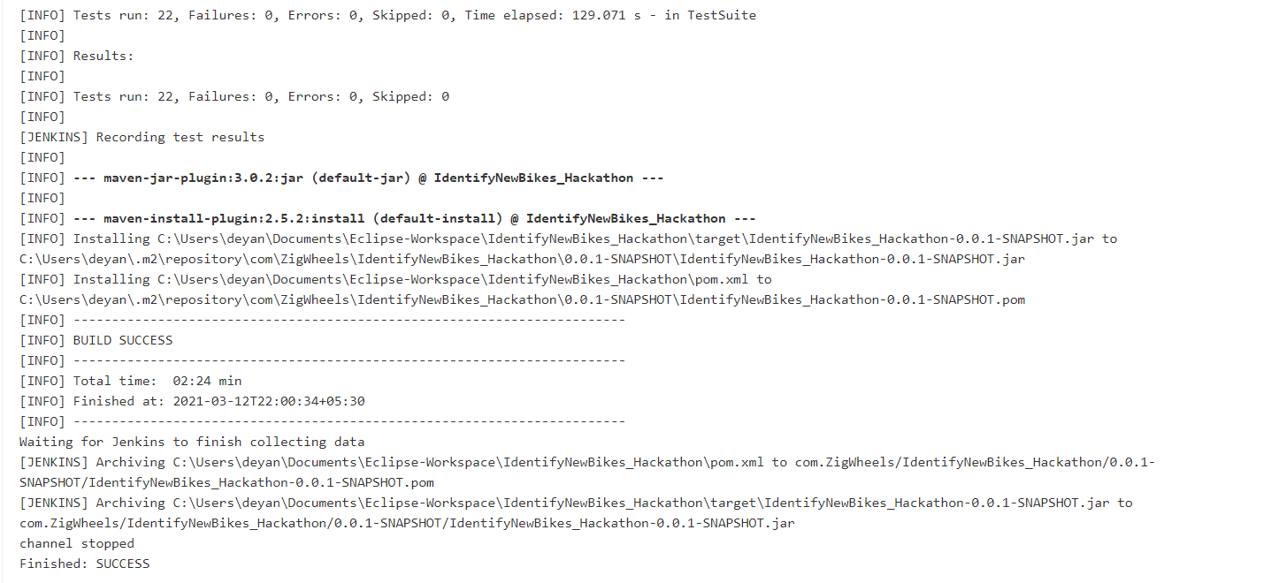
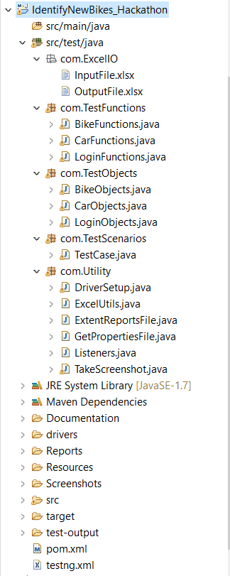
Jenkins output
Project Structure

Slide 15
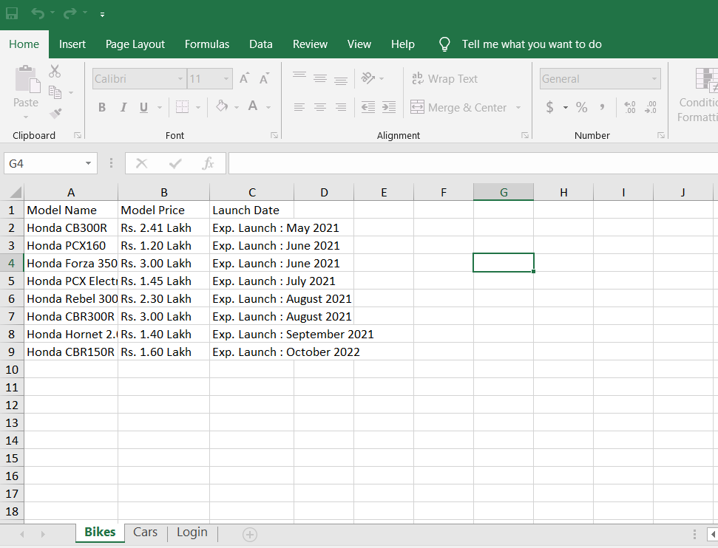
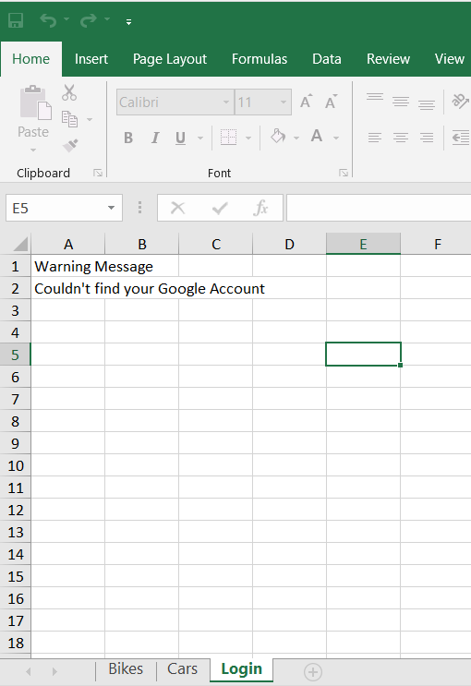
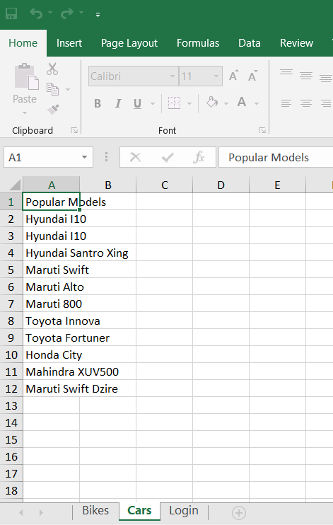
Excel outputs

Slide 16
Thank You
- HackOverflow

